Slide 1



SIGN LANGUAGE DETECTION
Team : bug slayers.

Slide 2
“Every Hand Tells A Story”

Slide 3
AIM
Develop an accurate and efficient sign language detector with the aim of enabling real-time translation and interpretation for the deaf and hard of hearing community."

Slide 4
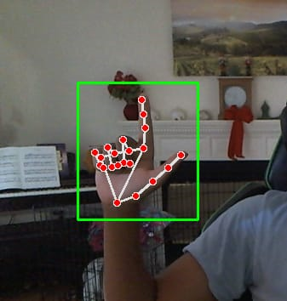
SIGN DETECTION USING WEB CAMERA
Detecting sign language using a webcam involves several steps:
Capture Video: Access the webcam feed
Hand Detection: detect and localize hands in the video frames.
Hand Tracking: Once the hands are detected, track them across consecutive frames to follow their movements.
Gesture Recognition: Analyze the hand movements and gestures to recognize sign language signs.
Feedback: Provide feedback to the user, such as displaying the recognized signs or translating them into text or speech.

Slide 5
Features
Real-time Detection: The system should be able to detect and recognize sign language gestures in real-time, providing immediate feedback to the user.
Multi-language Support: Support for recognizing multiple sign languages to cater to a diverse user base.
Accuracy: High accuracy in detecting and interpreting sign language signs to ensure effective communication.
Customizable: Ability to customize and train the system with new signs or gestures to expand its vocabulary.
User Interface: A user-friendly interface that displays recognized signs, translates them into text or speech, and provides feedback to the user.
Robustness: The system should be robust to variations in lighting conditions, hand orientations, and backgrounds to perform reliably in different environments.
Accessibility: Designed to be accessible to users with disabilities, with options for visual and auditory feedback.
Privacy: Respect user privacy by proc

Slide 6
Why?
Communication Barrier: Addressing the significant communication barrier faced by the hearing-impaired community due to the lack of widespread understanding of sign language.
Independence: Empowering individuals to communicate independently without relying solely on interpreters or written text, thereby fostering autonomy and self-confidence.
Inclusivity: Promoting inclusivity and equal participation in various aspects of society, including education, social interactions, by bridging the gap between the hearing and hearing-impaired communities.
Advancements in Technology: Leveraging advancements in computer vision and machine learning technologies to develop innovative solutions that improve the quality of life for individuals with disabilities.

Slide 7
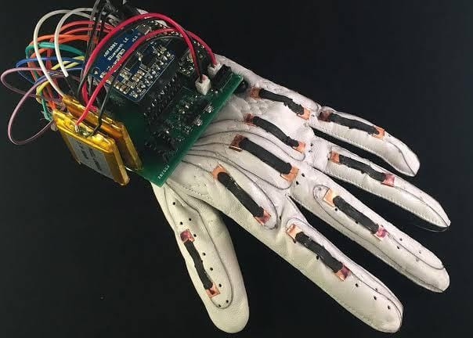
FUTURE WORK
SIGN DETECTION USING
SENSOR GLOVE

Slide 8
“HANDS THAT SPEAK, BRING HEARTS TOGETHER.”

Slide 9
THANK YOU
Have any question?

